Slide 1
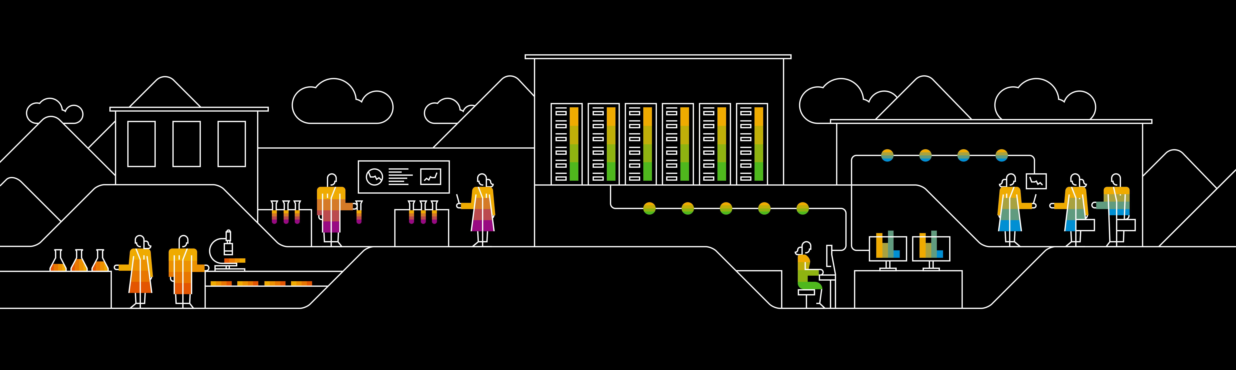
Introduction to Lean Kanban systems
Agile & DevOps Competency Center, SAP
April 08, 2019

Slide 2
Agenda
Kanban and theories behind
Context switching
Little’s law
Theory of constraints
Feedback loops
Kanban principles
Visualize work
Limit WIP
Manage flow
Everyday Kanban
Enterprise Service Planning Management System
Management System
Activities, Roles
Forecast
Pain Points to be addressed

Slide 3
Background : Kanban and the theory behind it

Slide 4

Kanban principles
01
Identify potential for improvement
The ”reduce waste” concept in software development is evolved to do not just tackle repeatable steps but automate repetitive and eliminate steps or items that does not add value
02
Increase efficiency
On software development, this principle focuses on improving the process, rather than the people.
03
Eliminate bottlenecks
This evolves identifying steps in the software development process where work that needs attention is queuing up to too great a volume for the work to keep flowing smoothly.

Slide 5
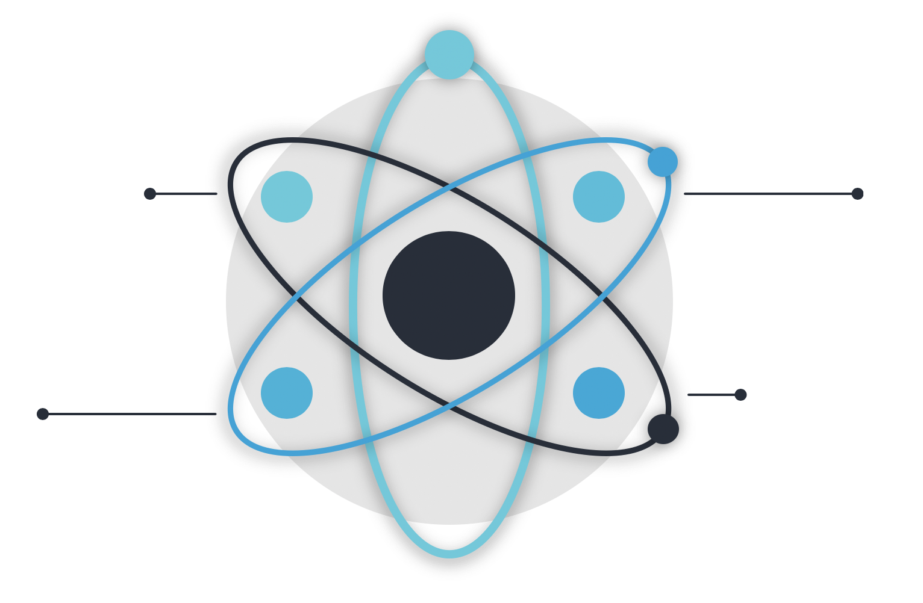
Theories behind it
Context Switching
Theory of Constraints
Public enemy #1 in creative work. “One thing at the time” is most effective
“ A chain is not stronger than it’s weakest link “
Feedback Loops
Little’s Law
Feedback is the creator of knowledge. As short feedback loop as possible.
Cycle time = Work in process / throughput

Slide 6
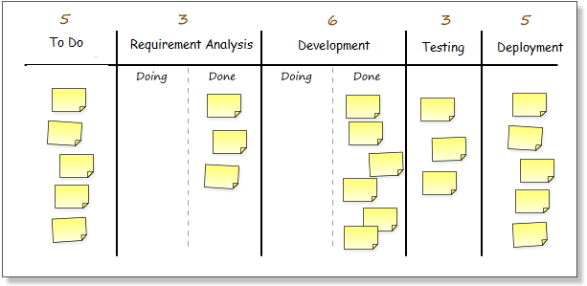
Kanban board
Limit WIP
Frequent replenishment is more agile.
On-demand replenishment is most agile.
Pull
Items can be prioritized or discarded here.
Workflow

Slide 7
Kanban Practices

Slide 8
Kanban General practices
Visualize with a Kanban Board
Limit Work-In-Progress
Manage Flow
Make Policies explicit
Implement Feedback loops
Improve Collaboratively, evolve experimentally

Slide 9
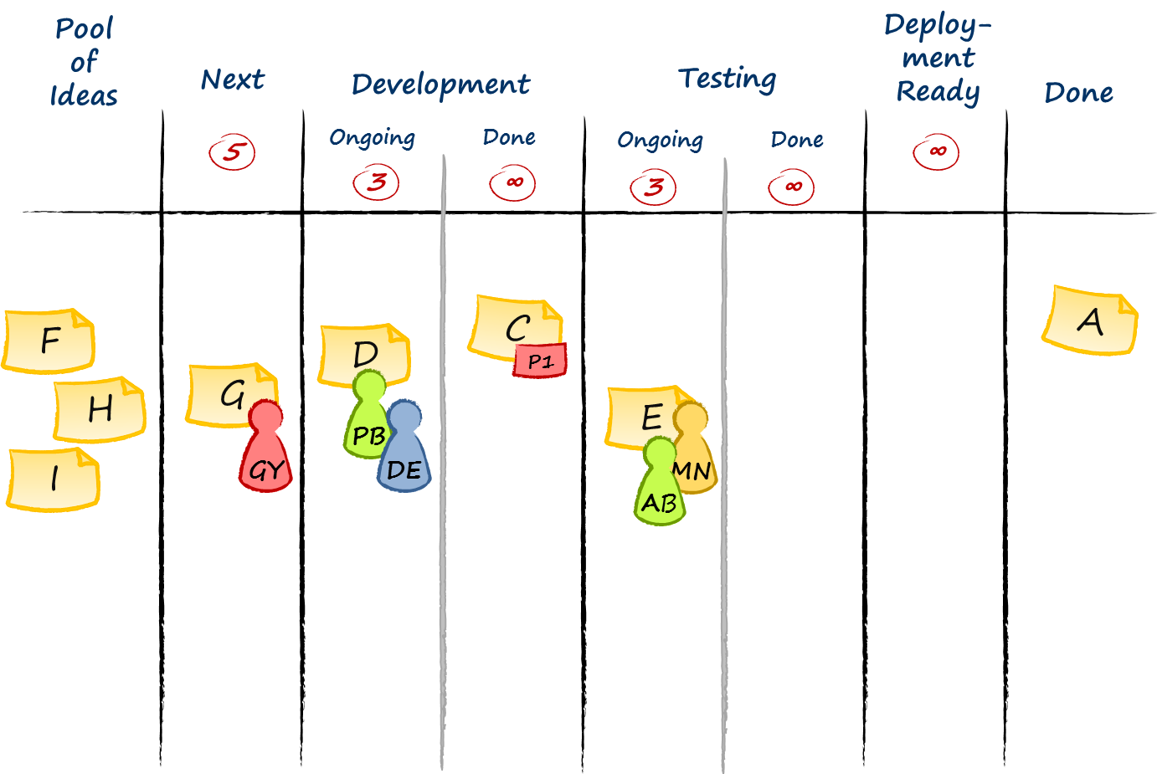
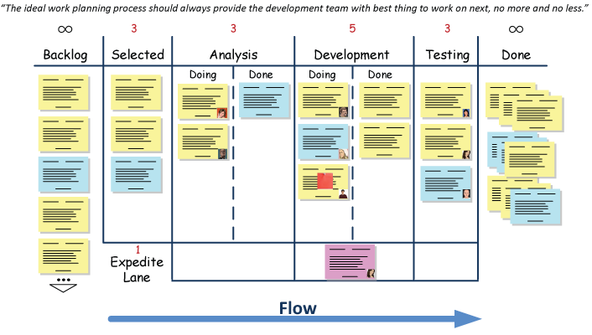
Visualize
Kanban board – whiteboard or other empty wall space
Columns represents steps in work process
Work tasks represented by cards or stickies
How to find columns? Dry-run a few tasks through your work process
Avatars
Explicit policies

Slide 10

Limit WIP
WIP means all the work that you have going on right now. From commitment point until delivery point.
Limit WIP to secure flow
Set WIP limit – pick a number and try it out ( then learn and adjust )
WIP per column. Avoid per whole board as least initially. Based on the processing time of each time.
Stop starting, start finishing!

Slide 11
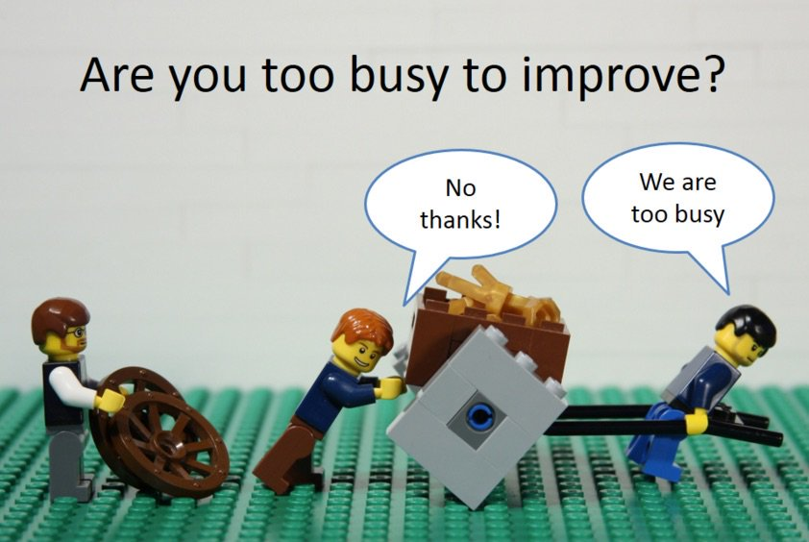
Manage flow
Flow is when each part of the work moves from one value adding step to another without any waiting times or delays
Limit WIP
Remove blockers ( swarming )
Continuous improvement – real purpose of Kanban
Retrospectives
Root-cause analysis
Improvement Kata ( Toyota )

Slide 12
Everyday Kanban

Slide 13
“Stop starting
and start finishing!”
Common sense

Slide 14
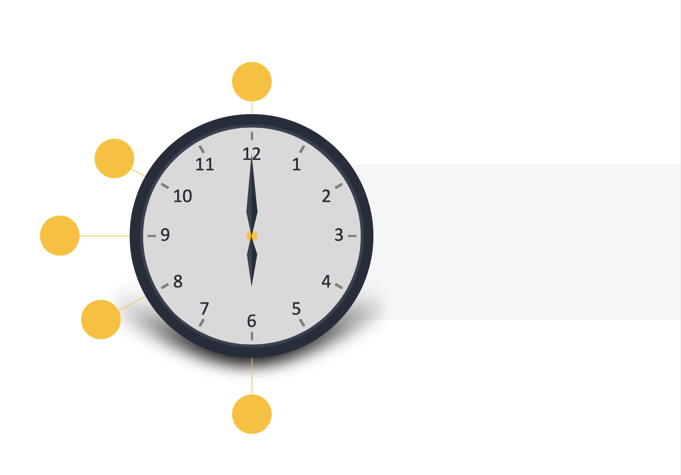
Where to start?
Start with what you do now
Agree to pursue incremental, evolutionary change
Respect the current process, roles, responsibilities & titles
Encourage acts of leadership at all levels
Improve collaboratively
Notes:
The Kanban method does not prescribe a certain setup or procedure. You can overlay Kanban properties on top of your existing workflow or process to bring your issues to light so that you can introduce positive change over time. This makes it very easy to begin a Kanban implementation as you do not have to make sweeping changes
Kanban recognizes that there may be value in the existing process, roles, responsibilities, & titles. You have existing pieces in the way you do what you do that are working properly and worth preserving. Kanban doesn’t prohibit change, but it doesn’t prescribe it either. If you do make changes, Kanban encourages incremental change. Incremental change doesn’t create the level of fear that impedes progress, which allows you to generate broader support for your Kanban implementation. It also makes it easier to implement Kanban. Small course corrections are also just inherently easier than altering the complete process.
Start with what you do now : You can overlay Kanban properties on top of your existing workflow or process to bring your issues to light so that you can introduce positive change over time.
Agree to pursue incremental, evolutionary change : The Kanban method is an approach to change management that is designed to meet minimal resistance. Therefore it encourages continuous small incremental and evolutionary changes to your current system
Respect the current process, roles & Respo : You have existing pieces in the way you do what you do that are working properly and worth preserving. Kanban doesn’t prohibit change, but it doesn’t prescribe it either. If you do make changes, Kanban encourages incremental change
Encourage acts of leadership at all levels : Some of the best leadership comes from everyday acts from people on the front line of their respective teams. Everyone needs to be fostering a mindset of continual improvement (kaizen) to reach your optimal performance as a team/department/company
Improve Collaboratively : The Kanban method suggests that a scientific approach is used to implement continuous, incremental and evolutionary changes

Slide 15
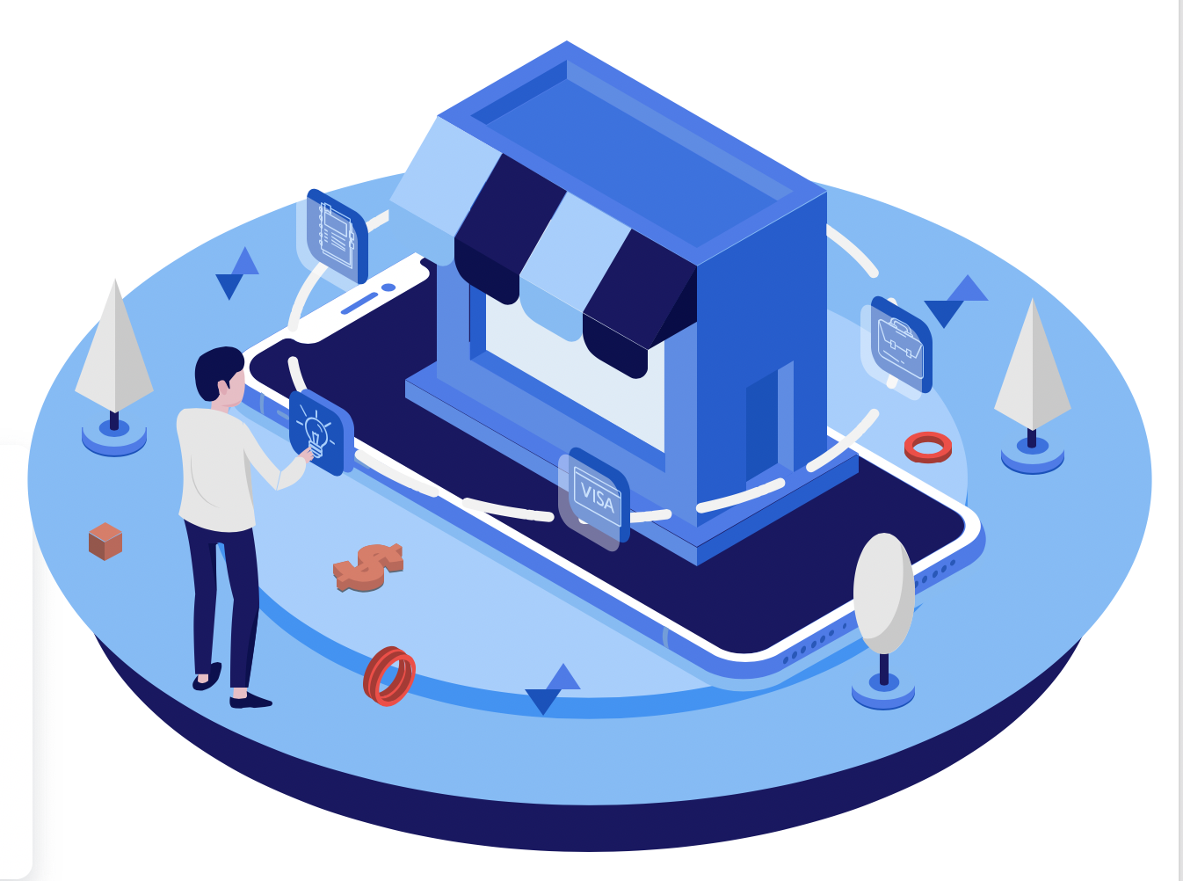
Cadences
Not too prescriptive on “ceremonies”
The Kanban system is composed by 7 non mandatory “cadences”, in which 4 are reviews and 3 are checkpoints or sync up meetings. All of them with goal to validate experiments and define actions based on data. Here are listed the more important :
1
2
3
Replenishment
aka ’4 Rs’
Daily sync
Service Delivery Review
Review ( including demo, if possible
Risks
Retrospective
Refresh backlog
Walk the board right to left and top to bottom
Any other business (AOB )
Optional daily demo
Examine and improve the effectiveness of a service, analyzing the latest weeks deliveries

Slide 16
Kanban board
Limit WIP
Frequent replenishment is more agile.
On-demand replenishment is most agile.
Pull
Items can be prioritized or discarded here.
Workflow

Slide 17




Designing the board
01
02
03
04
Visualize and map the flow of work
Set initial limits on your work in progress
Get your works in progress on the board
Inspect and adapt, then improve
Notes:
You have to visualize and map out the process that is being followed to complete work. This will give you – and everyone in the organization, not just the members of the team – more than a glimpse of the whole process. This way, they will be knowledgeable about all its aspects, so they can contribute more. This will also be useful in monitoring the progress of work of a team.
Use kanban cards or sticky notes to represent the work that will be done. If the processes are simple enough, mapping it out should be just as simple, with straight vertical lines down the board. However, in the event that the processes are quite complex, it may require both vertical and horizontal lines, often intersecting each other at some points.
We have mentioned earlier that one of the benefits of using the Kanban method is that work in progress becomes limited. When designing your kanban board, you have to set initial work in progress limits, meaning, at any point in time, the “CURRENT”, “WIP”, “IN PROGRESS” or “IN WORK” section (depending on what title or label you have chosen) should have only a maximum number of sticky notes.

Slide 18
Enterprise Service Planning management system

Slide 19

ESP Management System
A complete management system for improving communication, collaboration, and decision making across an organization
ESP gives the organization a way to respond faster with greater business agility
ESP coordinates strategic initiatives with current capability to deliver
Notes:
Enterprise Services Planning is a management system that uses the techniques proven by the Lean Kanban community to achieve greater coordination and alignment across multiple departments, remote offices, for internal and external customers. It enables agility without loss of management control.
We want the business to reach ”fit for purpose”. Imagine a system to create and delivery pizzas. We need first the right menu, good flavors and right to the point menu. Then we need the capability to bake the pizza. The the capability to delivery quick and keep the quality during the delivery. Everyone want to enjoy a warm and nice pizza at your own place at the end.So, we need a system with “fit for purpose to archieve this.
ESP 3 organization steps : Seeing services ( Identify interdependent services in your organization ) --- 2 Kanban each service ( create a Kanban system for each service )-----3 feedback loop system ( implement a set of responsive feedback loops )
Scaling Principles : 1- You scale out in a service-oriented fashion one service at a time. 2- Design each Kanban system from first principles using static, do not attempt to design a gran solution at enterprise scale. 3. Use the Kanban candences as the management system that enable balance, leasing to better enterprise services delivery

Slide 20
ESP Management System
Mechanism to consider existing outcomes and compare them to desired outcomes
Is our current service delivery “fit for purpose” in the eyes of our customers?
Is our current capability driving our strategic goals as a business?
Use the Kanban cadences as the management system that enables balance , leading to better enterprise services delivery

Slide 21
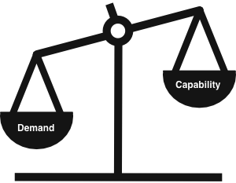
Elements of Enterprise Services Planning
Kanban
Feedback loops : Cadences
Probabilistic forecasting
Risk management
Shape demand and improve capability

Slide 22
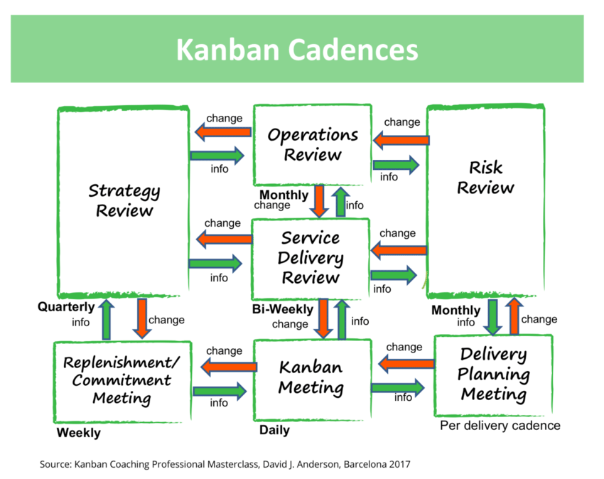

Slide 23
What are the activities of ESP Cadence information flow?
Take data and other input collected from each Kanban system
Observe signals that adjustments to the system is needed
You aren’t delivering work when you promised it
Your customer has some new dissatisfaction or new request
Or, consider current status and decide how to move forward
What work is ready to be delivered
How can we cope with a new competing product?
Discuss and decide on actions
Police changes
Apply techniques to shape demand or modify capacity
Communicate decisions

Slide 24
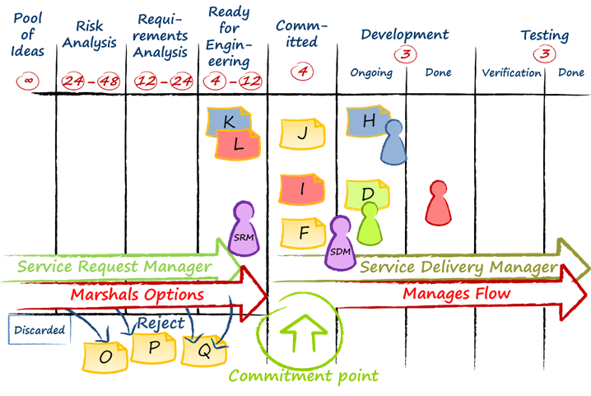
Roles are emerging on Kanban and ERP

Slide 25
Sequencing policies

Slide 26
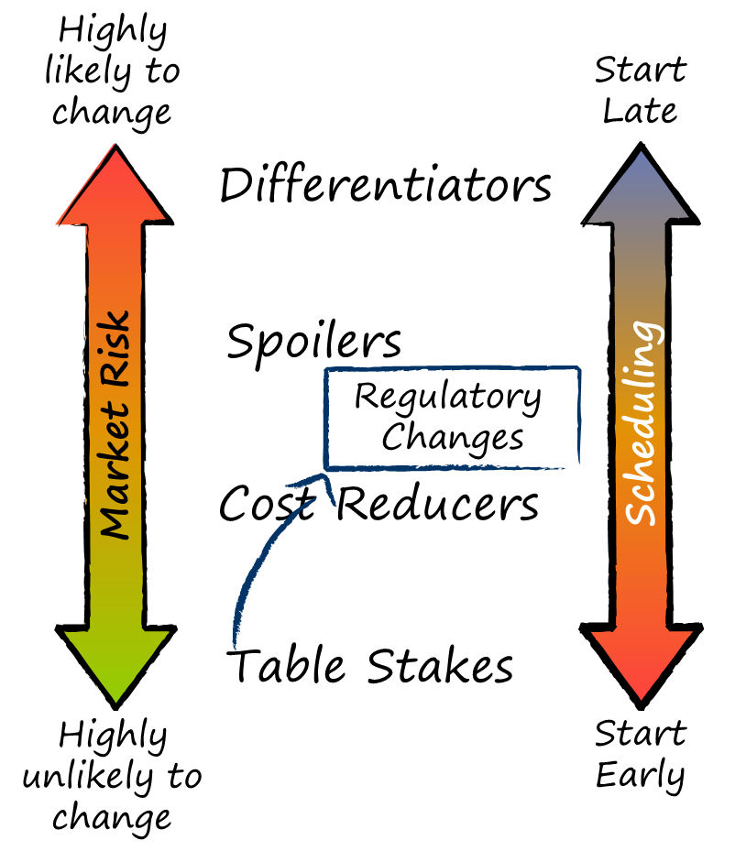
Sequencing policies
Risk assessment informs scheduling
Create sequencing & capacity allocation policies
Risk is a multi-dimentional problem
Policy-based scheduling is more powerful than traditional backlog prioritization
Notes:
Risk Assessment Informs Scheduling
Instead we build a project schedule based on sequencing policies. Sequencing policies are based on risk profiles and each work item in the project backlog should have been profiled using a (usually qualitative) risk assessment framework. A very powerful risk dimension is one I call "market risk of change". It is generally described with 5 categories: table stakes; cost reducers; regulartory changes; spoilers (or catch up); and differentiators. This approach is described in my book, Lessons in Agile Management. Other classes are possible within this categorization scheme. On occasion I will embellish the classifications with others such as "misdirector". However, the five described here are the most common. The key point is to pick risk dimensions and classification taxonomies that are relevant to your project. This particular classification is useful for projects where the product of the project is a customer deliverable product or service than competes in market of alternative products or services, and may be in a regularted industry.
If each feature or requirement for the project is classified using this taxonomy then we can build a schedule for the project by setting policies based on the risk classification.
Table stakes have no risk of change during the life of the project. As a result they can be started first. While Regulatory changes are table stakes - you can't complete the project without them, they are called out as a separate category because regulations are subject to lobbying and fickleness from governments and regulatory authorities. It may be possible and would be desirable to separate regulatory changes into those which will not change during the life of the project and those which are subject to regulatory review, appeal, or a change in government or regulating authority. The dates of any possible changes should be noted, so that we know when the item ceases to be subject to change. For example, if an election and change of government is known to affect a requirement then the election date should be tagged with the requirement definition.
As we move up the scale through cost reducers, spoliers and differentiators the amount of uncertainty about the requirement changes and hence the greater the risk that the definition of the requirement will change or that the need for the item all may change. We do not want to work on items that will be deleted from scope or that may be subject to significant changes. So these items should be deferred until later in the project.
Create Sequencing & Capacity Allocation Policies
If there is no risk that the project delivery date will be brought forward then we would sequence all table stakes, then all cost reducers, then all spoilers, then all differentiators. Regulatory changes would be scheduled as soon as we know they are no longer subject to change prior to the project delivery date. Projects where there is no risk of the delivery date coming forward are usually regulatory in nature or are related to a seasonal business or industry, common in the clothing, apparel and fashion industry, for example, or a major event such as the World Cup or Olympic Games. So if we have a project of this nature, and we have our requirements assessed for the market risk of change then we can write a simple policy definition for sequencing work through the kanban system. Items of the same category, e.g. cost reducers, can be done in any order, there is no risk management benefit from prioritizing them or sequencing them in any finer detail. This is true only if market risk of change is the only risk dimension we care to manage. Typically we would have other risk dimensions to consider so the policies will be more complicated than described here.
If there is a risk that the delivery date may be brought forward, typical of commercial product or service projects, then we should hedge this risk. The most value is in the differentiators or the spoilers, depending on strategy and market positioning, so we should hedge the risk of moving the delivery date forward by allocating capacity in our kanban system to higher value, higher risk items. We can facilitate this by segmenting our requirements. If our product or service targets multiple market segments or personas then each requirement should be tagged by the segment or persona it supports. We should ask our marketing people to prioritize or sequence the market segments or personas based on their preferences - most likely based on current market objectives. If for example, we hope to grow our market share by targetting teenagers, then the segment or persona for the teenager will be given priority. In addition, we should create policy to alllocate capacity on a sliding scale during the project lifecycle. For example, we may want 80% allocated to table stakes initially, falling to 0% before project completion, while only 10% is allocated to differentiators at the beginning, growing to 80% by the end of the project. This capacity allocation affects the kanban in the system and provides specific pull signals telling us what type of requirement to pull at any given time.
Risk Is A Multi-Dimensional Problem
Of course, this blog post is only looking at a single risk dimension and risk is a multi-dimensional problem on most projects. The qualitative risk assessment framework fills a full day of the Managing Risk Masterclass and some of its contents fill around 25% of the Advanced Practitioner curriculum classes on Scaling with Kanban, or Project Management with Kanban. There is a lot to learn and a lot to consider in this field, so typically, our scheduling policies are more complex than decsribed above. For example, we might consider technical risk. If an item is a differentiator but also technically risky - we have never done it before and don't know how to do it - then we might have a policy that states items of this category should be split into two. The first should be a prototype (or "spike") to determine viability, this item should be scheduled early in the project to provide us with useful information. The second item from the split should be the high fidelity feature based on the new technical capability. This differentiating feature should be deferred until late in the project.
Policy-Based Scheduling Is More Powerful Than Traditional Backlog Prioritization
There is no need to sequence every item in the scope of a project. In fact individual items should not be sequenced. A small set of policies based on risk assessment will guide selection of items as kanban signals indicate capacity to start an item. This set of policies is easier to maintain than a prioritized project backlog and is more powerful as a risk management tool. It is easy to explain why a policy was written and if circumstances change, it should be self-evident when policies need to change. Policy changes will immediately affect new selection decisions for the kanban system. There is no need to maintain the project backlog. All that is required is that items in the project scope are assessed for risks at the time of commitment and that the project scheduling policies are maintained based on the risk management approach advocated by the project manager.

Slide 27
Forecasting

Slide 28
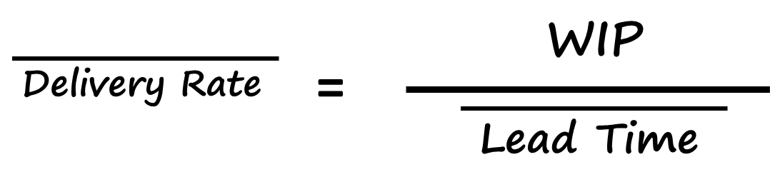
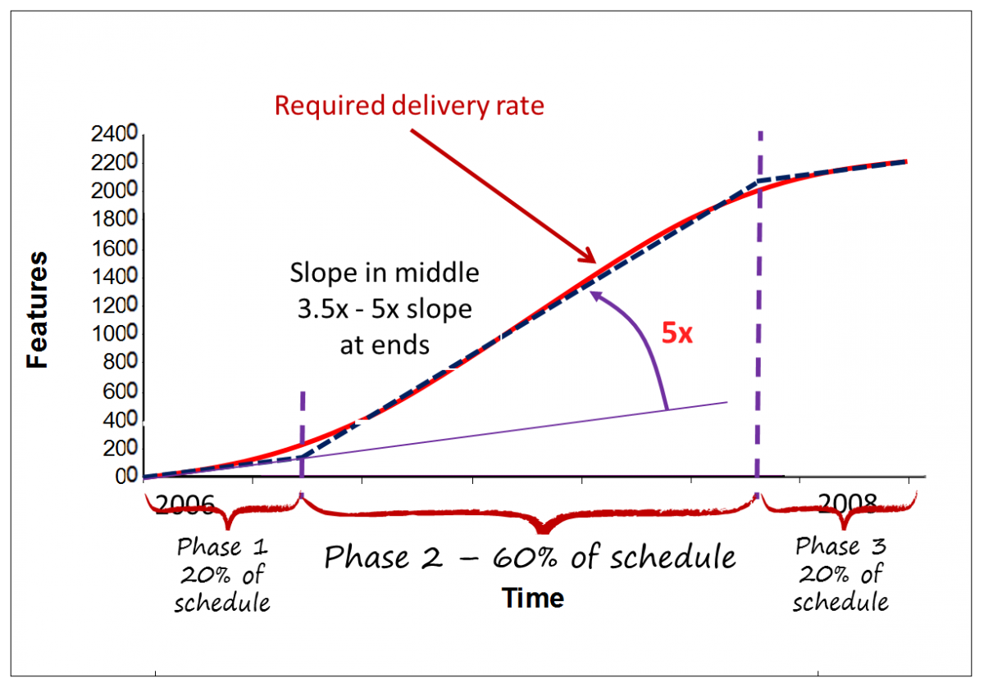
Forecasting
Statistical enablers for project forecasting
Building a schedule forecasting
Using capacity allocation to manage requirements risks
Notes:
Statistical Enablers For Project Forecasting
There are two key ideas that enable forecasting projects in Kanban: the first is the lead time distribution for work pulled through the kanban system; and the second is the Little's Law equation from queuing theory.
Figure 1. Lead Time Distribution
Figure 1 shows a lead time distribution for work items (typically, project features or requirements) flowing through the kanban system. To use a historical lead time distribution like this we need to understand a few assumptions and be sure we've chosen our data correctly. We must also believe that our future observed capability will be similar to past performance. This is particularly true in environments with low flow efficiency where the individual's skill and capability, the technical practices used, nor the size or complexity of the requirements have a significant influence on the lead time. Hence, in low flow efficiency environments, we can change the people, dramatically change the method of capturing the requirements and change the technical working practices while observed lead time distribution is not significantly affected. In higher flow efficiency environments we'd want to pay attention to keeping the skills and experience of the individuals fairly similar to those involved when we capatured our historical data, and to keep the working practices and the methods of analysis and requirements development fairly similar. This should insure that we can expect lead time distributions in future that are sufficiently similar to our existing data that we can reliably use the historical data for a forecast.
Secondly, we need single modal data for a good forecast. To get single modal data for our lead time distribution, we need separate distribution curves for work of different types or classes of risk. Hence, risk assessment of the requirements and clustering and filtering of historical data by risk categories is a key to producing a good forecast.
Thirdly, we need to know how far back historically we should sample our lead time histogram to create our best fit distribution curve. This is where a lead time run chart comes in handy. We can observe changes to the system design in the run chart data in terms of the mean value and the spread of variation of the data points. If there are discontinuities, usually associated with system design changes (hopefully, improvements) then we only wish to sample as far back as the point where the mean and spread of variation changed. In other words, we want a histogram of data that reflects current conditions and capability unpolluted with older data points. Another way to find this point in time is to monitor the kanban system liquidity and look for dates where the liquidity level changed significantly. Such a date would provide the historical back stop point for sampling data for our histogram.
Once, we have a histogram for each cluster of risks (classes of service) or each type of work within the project scope, and assuming out project scope and requirements are tagged by type or risk category, as discussed in part 2 of this series, then we have the ability to forecast our project schedule using Little's Law.
Figure 2 Little's Law
The Kanban variant of Little's Law states that the mean delivery rate of work items leaving the kanban system, is equal to the number of kanban in the system (the WIP limit) divided by the mean lead time through the system. Hence, if we know the WIP limit of our kanban system, and we know the mean of our lead time distribution, we can calculate how quickly our completed work will arrive ready for delivery at the end of the project.
Building A Schedule Forecast
Figure 3 shows a simple three phase model that we often use for projects of medium to large scale. This model has been shown to be effective for projects from 6 weeks long to multiple years in duration. The parameters in the model are my own personal choices and you might like to vary your parameters but 3 phases is probably sufficient. I assume 20% of the timeline for phase 1 - a period of relatively low flow efficiency. The next 60% of the timeline is phase 2 - a period of high flow efficiency, some Agilists refer to this as "hyper-productivity". We end with a period of lower flow efficiency for the remaining 20% of the timeline. I first documented this model in my 2003 book, Agile Management for Software Engineering. The probabilistic forecasting technique described here predates Kanban. However, the use of kanban systems makes the forecast so much more accurate by improving the consistency of the lead time.
Figure 3. 3 Phase Project Schedule Forecast
FIgure 3 assumes a project with homogenuous requirements - in other words requirements that are all of the same type and of the same class of risk. What do I mean by this? If for example our requirements are all captured in the same way, for example, User Stories, we might treat them as all of the same type. If some have a vendor dependency while others don't we would typically see multi-modal data in our lead time distribution because the vendor dependency causes a delay and longer lead times result. It would be wrong in such a case to treat all the requirements homogenuously and hence we would want to filter for the risk of vendor dependency or not. So we'd want our requirements tagged to show whether they were vendor dependent or not. So we would no longer have homogenuous requirements, we'd have two different classes and we'd need to simulate each separately.
Using Capacity Allocation To Manage Requirements RIsks
For each separate batch of requirements by class or type, we would build a simulation. For example, if we have regulatory requirements as described in part 2 of this series then we would want to forecast those separately from the non-regulatory work within the project scope. As discussed in part 2, regulatory requirements typically have fixed delivery dates and the project delivery date is typically tied to the regulatory compliance date. Hence, we have a batch of regulatory requirements to be delivered before the end of the project. This gives us an opportunity to introduce a capacity allocation in our kanban system to pull regulatory requirements at a steady pace throughout the lifetime of the project. We know the size of the batch of regulatory requirments. We know the delivery date. We know today's date. So we can calculate a required mean delivery rate. We know the lead time distribution for pulling regulatory requirements through our kanban system. From these parameters we can calculate a WIP limit for regulatory requirements. This will become our capacity allocation within the whole kanban system. We might design a lane or use a color of ticket to signify regulatory requirements on our visual board. We would set a WIP limit for tickets of that color or in that lane. Effectively, we have created a kanban sub-system designed to pull the regulatory requirements at the pace needed, starting now and insuring delivery of all of them before the deadline for the project.
Should we sequence our regulatory requirements? As discussed in part 2, it depends whether or not some of our regulatory requirements are still subject to change - due to lobbying, fickleness of the regulator, or a change in political leadership. If not, then our regulatory requirements are homogenuous from a business risk perspective and we can pull them in any order we like. There is no need to sequence them. If some of them are still subject to change then those should be deferred until later in the project. At the beginning and through the early phases of the project we should sequence and select requirements that we know are stable, while deferring unstable requirements until any ambiguity is resolved.

Slide 29
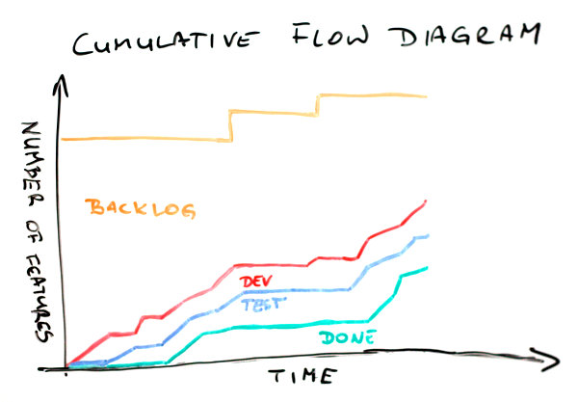
Forecasting
A probabilistic forecast is likely to be significantly more accurate - more similar to the actual outcome - than a traditional deterministic plan that requests an estimate for each work item within the project scope.
Forecasting models
3 phase ( x model )
Montecarlo simulation feature
Notes:
While using historical data to form lead time historgrams, developing best fit distribution curves, forecasting completion rates, establishing WIP limits, setting capacity allocations and influencing capacity allocation policies all sounds very complex and involves some basic understanding of statistics, making project plans this way is actually very fast and easy. Given that the requirements have been assessed and tagged with risk categories, it ought to be possible to build a project forecast within a few hours. Even for significant projects spanning greater than 1 year and costing in excess of $10,000,000 it ought to be possible to build a reliable, high quality forecast in less than 1 day using only a couple of people to gather and analyze the necessary data.
A probabilsitic forecast made in this way is likely to be significantly more accurate - more similar to the actual outcome - and is also significantly faster and cheaper to create, than a traditional deterministic plan that requests an estimate for each work item within the project scope. The major advantage from probabilistic forecasting is that we do not need to interrupt workers doing customer-valued work in order to ask them to estimate future, and often speculative, work. Eliminating this wasteful disruption has been shown in many Kanban case studies to significantly improve delivery rates, lead times, predictability and quality.
While this article described the 3-phase, so called Z-curve, forecasting model, those of you using LeanKit or Swift Kanban products can utilize the Monte Carlo simulation feature to produce even more robust forecasts for project outcomes. Forecasting is fast, cheap, and tends to be considerably more accurate than traditional estimation and planning methods. Kanban systems enable forecasts to be used actively to manage project risks and insure good project governance by making explicit policies related to scheduling and capacity allocation.

Slide 30
Risk Review

Slide 31
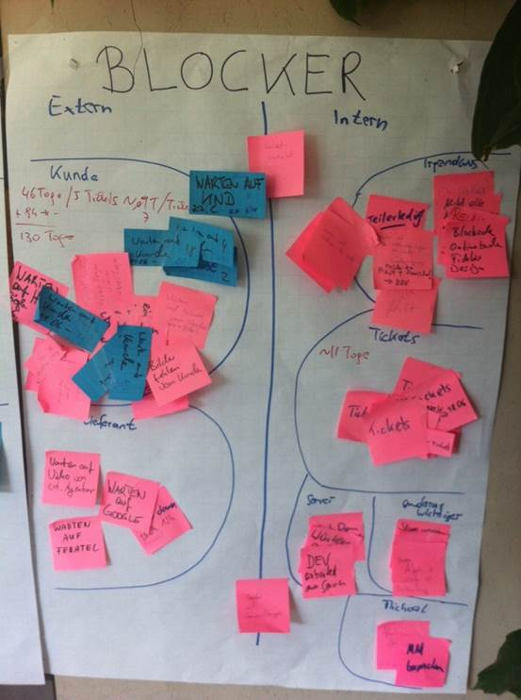
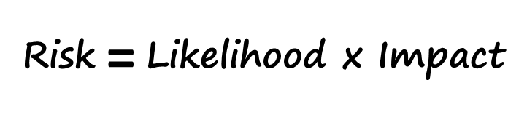
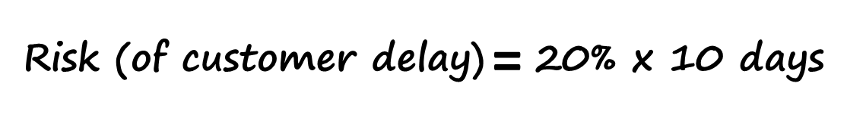
Risk Review & block clustering
The Blocker Clustering technique was developed by Klaus Leopold and can be used to drive process improvement as well as managing project risk.
Use stickers to write the reason for the block and the number of days blocked over a period of time ( 1 month ideally)
Event risk analysis
Risk Review
Process Improvement
Notes:
This popular equation appears in a number of classic bodies of knowledge on project management. The purpose of the is to calculate the magnitude of given event occurring. The blocker clustering provides us with the information to plug straight into this equation. If you look carefully at the picture, the "customer" cluster ("kunde" in German") shows a total impact of 130 days ("tage" in German). If we know the precise number of instances (tickets) that contribute to this total, which appears to be 13, then we can deduce that the average blocking impact of a delay waiting on a customer response is 10 days for each item that gets blocked. So we know, risk (customer delay) has an average impact of 10 days per item. If during this time period we had processed a total of 65 tickets then the likelihood of a ticket being blocked with a customer is 13/65 which equals 1/5 or 20%.
So the blocker clustering exercise that uses tickets harvested from the kanban board directly informs the project risk plan.
The fifth general practice of the Kanban Method is "Implement Feedback Loops." Until recently there has only been 3 specific practices: the standup meeting; the service delivery review; and the operations review. With the official release of the LeanKanban Modern Management Framework in October this year, we are adding a fourth specific feedback loop practice, the Risk Review. Blocker clustering is one of the key collaborative activities you would conduct during a risk review.
The output from blocker custering doesn't just inform the project risk plan, it can also be used to drive process improvement. Higher impact sources of delay can be targeted for risk reduction and mitigation actions with the intent of eliminating the source of the delay or significantly reducing the likelihood of occurrence or the impact of occurrence. In this way, blocker clustering informs a model-driven improvement and the evolutionary process of improving service delivery in the organization.

Slide 32
Now, its your time to think

Slide 33
Pain points identified: do you know what to do?
Missing deadlines
Poor predictability
Overburdened, to busy
Dealing with dependencies
Shifting priorities
Quality Issues
Customer dissatisfaction
…..

Slide 34
Do you know techniques to improve?
Lead time distribution improvement
Flow efficiency improvement
Risk profiling for portfolios
System and staff liquidity
WIP limits
Class of service
Capacity allocation
Options Management
Kanban system volatility
Risk types; variability types
Forecasting with utility graph functions
…….

Slide 35
Appendix

Slide 36
What does Lean mean?
1
2
3
Reduce waste
Increase efficiency
Eliminate bottlenecks
This makes abundant sense for a repetitive, repeatable process
This is typically achieved by buying newer, more up to date machinery
This is achieved by restructuring the manufacturing workflow

Slide 37
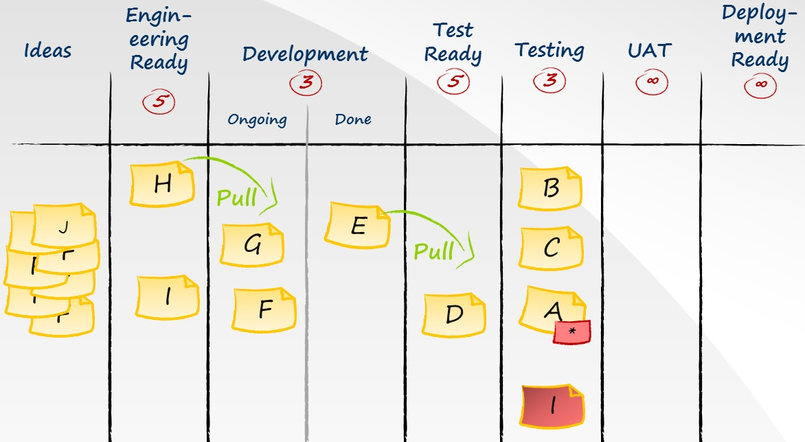

Kanban Lead Time
System Lead Time
Customer Lead Time
Commitment point

Slide 38




Kanban Ticket Design
Decorators (Shape & Color)
Sometimes used to highlight technical dependencies
# Number
Title ….
H
Letter
Sometimes used to visualize legacy process artifacts such as “priority”
Color of the ticket
Features/Issues
Typically used to indicate :
Features
Issues
Risk
Start
Item 1
Due
Item 2
Dates
Sometimes used to record work state
End
Item 3
Age (days elapsed)
SLA or
Target Date

Slide 39
Thank you.
Contact information:
Agile & DevOps Competency Center
Jam
Email

